Slide 1
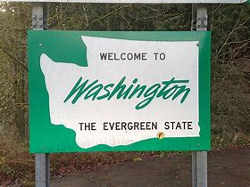

Open Government in
Washington State
______________________________
Wenatchee School Board Workshop
November 5, 2018
Prepared by Washington State Attorney General’s Office

Slide 2

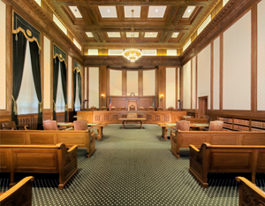
Historical Open Government Principles
"A popular Government without popular information, or the means of acquiring it, is but a prologue to a farce or a tragedy; or, perhaps both. Knowledge will forever govern ignorance....” ~ James Madison
"...a nation that is afraid to let its people judge the truth and falsehood in an open market is afraid of its people." ~ John F. Kennedy
“It has been said time and again in our history by political and other observers that an informed and active electorate is an essential ingredient, if not the sine qua non* in regard to a socially effective and desirable continuation of our democratic form of representative government.”
~ Washington State Supreme Court
*indispensable action

Slide 3

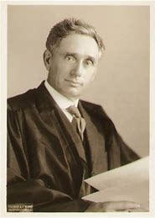
Open Government Laws are often called “Transparency Laws” or “Sunshine Laws”
This is because they “shine light” on government.
U.S. Supreme Court Justice Louis Brandeis once famously said, “Sunlight is the best disinfectant.”
___________________________________________________
Transparency builds public confidence in government.

Slide 4

U.S. History –
Federal Freedom of Information Act (FOIA) (1966) (federal records)

Slide 5
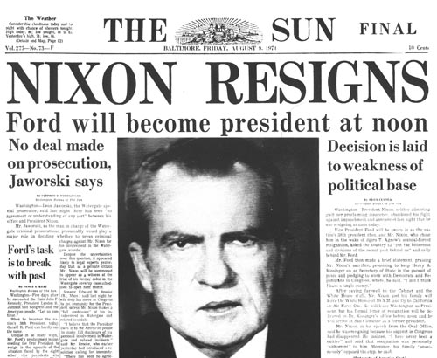
U.S. History – Watergate – 1970s
In 1974, after the Watergate scandal, FOIA was amended to force greater federal agency compliance.

Slide 6
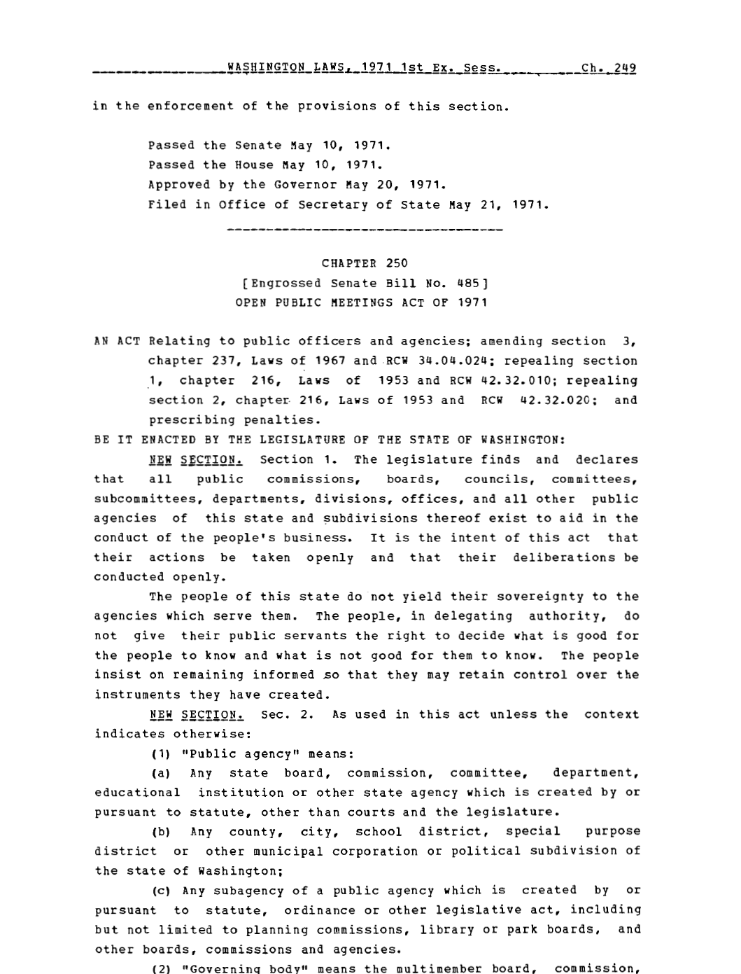

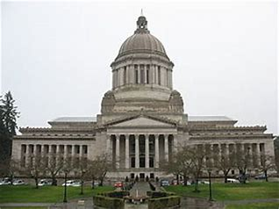
Washington State History – 1970s
Open Public Meetings

Slide 7
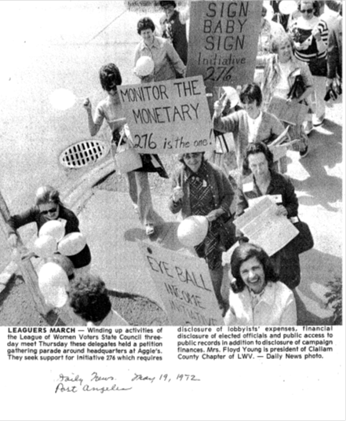

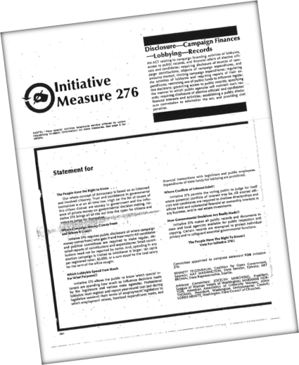
Washington State History – 1970s
Campaign Finance, Financial Affairs & Lobbying; PDC; Public Records

Slide 8
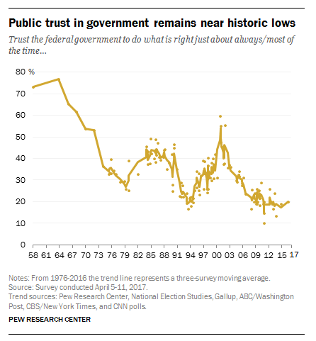
Public Trust & Government

Slide 9
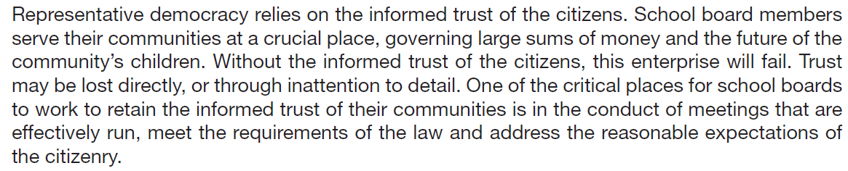

Public Trust & School Boards –
WSSDA Manual

Slide 10

Public Trust and Leadership
“Earn trust, earn trust, earn trust. Then you can worry about the rest.” – SETH GODIN

Slide 11
Washington - Two Different Statutes - Overview
Open Public Records
RCW 42.56
Public Records Act
(PRA)
Open Public Meetings
RCW 42.30
Open Public Meetings Act
(OPMA)

Slide 12

Intent
Open Public Records
Open Public Meetings
“The people of this state do not yield their sovereignty to the agencies that serve them.”
“The people, in delegating authority, do not give their public servants the right to decide what is good for the people to know and what is not good for them to know.”
“The people insist on remaining informed so that they may maintain control over the instruments that they have created.”
The “free and open examination of public records is in the public interest, even though such examination may cause inconvenience or embarrassment to public officials or others.”
“The people of this state do not yield their sovereignty to the agencies which serve them.”
“The people, in delegating authority, do not give their public servants the right to decide what is good for the people to know and what is not good for them to know.”
“The people insist on remaining informed so that they may retain control over the instruments they have created.”

Slide 13

Application
Open Public Records
Open Public Meetings
Formerly in RCW 42.17 – now RCW 42.56.
Applies to all public agencies, state and local.
Does not apply to courts.
Application to Legislature – pending.
Applies to “public records” which are defined to include “writings.”
Records are open unless there is an exemption authorized by law.
RCW 42.30.
Applies to all multimember public agency boards and commission governing bodies, and their committees.
Does not apply to courts.
Does not apply to Legislature.
Requires meetings of governing body to be open gavel-to-gavel, unless there is an exception authorized by law.

Slide 14

Touchstone:
Open Public Records
Records of public agencies are presumed open.
PRA is to be liberally construed.
Records or information in records can be withheld only by law (e.g. exemption in law).
Open Public Meetings
Meetings of agencies subject to the OPMA are presumed open.
OPMA is to be liberally construed.
Meetings or parts of meetings can be closed only by law (e.g. executive sessions).

Slide 15

Before We Begin… Some OPMA and PRA Transparency Headlines

Slide 16








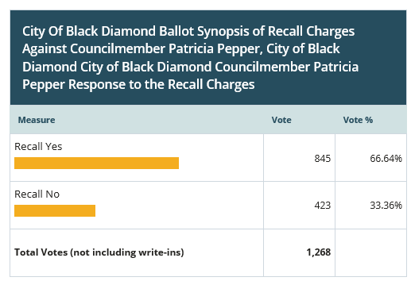


OPMA

Slide 17






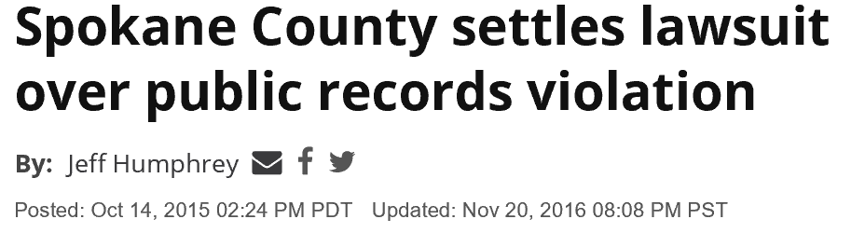
PRA

Slide 18
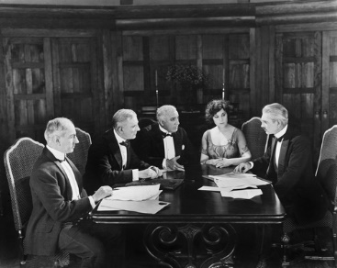
Open Public Meetings Act
(Gee, I wonder how I will vote. I love popcorn but how much should we spend on this? This is such an important decision!)
I move that we approve the purchase of a new popcorn maker!
Second!

Slide 19
Washington’s Open Public Meetings Act (OPMA)
Passed in 1971
Requires meetings to be open to the public, gavel to gavel
RCW 42.30

Slide 20
Purpose
“The people do not yield their sovereignty to the agencies which serve them.”
“The people, in delegating authority, do not give public servants the right to decide what is good for the people to know and what is not good for them to know.”
“The people insist on remaining informed so they may retain control over the instruments they have created.”
~ RCW 42.30.010

Slide 21

Purpose (Cont.)
Public commissions, boards, councils, etc. listed in OPMA are agencies of this state that exist to aid in the conduct of the people’s business.
Their actions are to be taken openly and deliberations conducted openly.
~ RCW 42.30.010
Act is to be “liberally construed.”
~ RCW 42.30.910
The purpose of the OPMA is to allow the public to view the “decisonmaking process.”
~ Washington State Supreme Court

Slide 22
OPMA Applies To:
Multi-member public state and local agencies, such as boards and commissions, as follows:
Any state board, commission, committee, department, educational institution, or other state agency which is created by or pursuant to statute, other than courts and the legislature.
Any county, city, school district, special purpose district, or other municipal corporation or political subdivision of Washington.
Any subagency of a public agency which is created by or pursuant to statute, ordinance, or other legislative act, including but not limited to planning commissions, library or park boards, commissions, and agencies.
Any policy group whose membership includes representatives of publicly owned utilities formed by or pursuant to the laws of this state when meeting together as or on behalf of participants who have contracted for the output of generating plants being planned or built by an operating agency.
~ RCW 42.30.020
These are the “public agencies” subject to the OPMA.

Slide 23
OPMA Does Not Apply To:
These entities:
  Courts
  Legislature
  Agencies not defined as “public agency” in OPMA, such as agencies governed by a single individual
  Private organizations
These activities:
  Licensing/permitting for businesses, occupations or professions or their disciplinary proceedings (or proceedings to receive a license for a sports activity, or to operate a mechanical device or motor vehicle)
  Quasi-judicial matters
  Matters governed by the Washington Administrative Procedure Act, RCW 34.05
  Collective bargaining
~ RCW 42.30.020(1), RCW 42.30.140

Slide 24

Governing Body
All meetings of the governing body of a public agency shall be open and public and all persons shall be permitted to attend any meeting of the governing body of a public agency, except as otherwise provided in RCW 42.30.
~ RCW 42.30.030

Slide 25
What is a Governing Body?
The multimember board or other policy or rule-making body
OR
Any committee of such public agency when:
  the committee acts on behalf of the governing body,
  conducts hearings, or
  takes testimony or public comment
  ~ RCW 42.30.020

Slide 26
What is a Meeting?
“Meeting” means meetings at which the public agency takes “action” ~ RCW 42.30.020
  “Action” means the transaction of the official business of the public agency and includes but is not limited to:
    Public testimony
    All deliberations
    Discussions
    Considerations
    Reviews
    Evaluations
    Final actions
    The requirements of the OPMA are triggered whether or not “final” action is taken. See upcoming slide on “final action.”
A “meeting” of a governing body occurs when a majority of its members (quorum) gathers with the collective intent of transacting the governing body’s business.
~ Citizens Alliance for Property Rights Legal Fund v. San Juan County

Slide 27


“Meeting” (Cont.)
Physical presence not required – a meeting can occur by phone or email, or text.
  An exchange of e-mail could constitute a meeting if, for example, a quorum of the members participate in the e-mail exchange & discuss agency business. Simply receiving information without comment is not a meeting.
      ~ Wood v. Battle Ground School District; Citizens Alliance for Property Rights Legal Fund v. San Juan County
      ~ Be careful about “reply all.”
Does not need to be titled “meeting” – OPMA also applies to “retreats,” “workshops,” “study sessions,” etc.
No meeting occurs if the governing body lacks a quorum.
  In Eugster v. City of Spokane (2002) the Court of Appeals described that when the facts show members are “polled” outside of a meeting and have knowledge they are acting in concert with others, that activity may lead to a conclusion that the members knowingly violated the OPMA.
  Issue: Serial meetings.

Slide 28
Final Action
“Final action” is a collective positive or negative decision, or an actual vote, by a majority of the governing body, or by the “committee thereof”
Must be taken in public, even if deliberations were in closed session.
Secret ballots are not allowed.
~ RCW 42.30.060, RCW 42.30.020
In Miller v. City of Tacoma (1999) the Supreme Court held that informal balloting of a quorum outside the public eye (in that case, in an executive session) violated the OPMA.

Slide 29

Travel and Gathering
A majority of the members of a governing body may travel together or gather for purposes other than a regular meeting or a special meeting, so long as no action is taken.
Discussion or consideration of official business would be action, triggering the requirements of the OPMA.
~ RCW 42.30.070

Slide 30
“Regular” Meetings
“Regular meetings” are recurring meetings held in accordance with a periodic schedule by ordinance, resolution, bylaws or other rule.
A state public agency must:
  Yearly, file with Code Reviser a schedule of regular meetings, including time and place
  Publish changes to regular meeting schedule in state register at least 20 days prior to rescheduled date
  ~ RCW 42.30.070; RCW 42.30.075; RCW 42.30.077

Slide 31

“Regular” Meetings (Cont.)
Agenda notice requirements apply to regular meetings.
RCW 42.30.077 requires governing bodies to make the agenda of each regular meeting of the governing body available online no later than 24 hours in advance of the published start time of the meeting.
This law does not:
  Apply to agencies that do not have websites.
  Apply to agencies that employ fewer than 10 full-time employees.
  Restrict agencies from later modifying an agenda.
  Invalidate otherwise legal actions taken at a regular meeting where agenda was not posted 24 hours in advance.
  Satisfy public notice requirements established under other laws.
  Provide a basis to award attorneys fees or seek court order under OPMA if agenda is not posted in accordance with this law.

Slide 32

“Special” Meetings
A “special meeting” is a meeting that is not a regular meeting (not a regularly scheduled meeting).
Called by presiding officer or majority of the members
Notice - timing: 24 hours before the special meeting, written notice must be:
  Given to each member of the governing body (unless waived)
  Given to each local newspaper of general circulation, radio, and TV station which has a notice request on file
  Posted on the agency’s website [with certain exceptions in RCW 42.30.080(2)(b), for example, if the agency does not have a website)]
  Prominently displayed at the main entrance of the agency’s principal location and the meeting site (if not that same location)
  ~ RCW 42.30.080

Slide 33

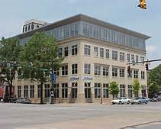

“Special” Meetings (Cont.)
Notice - contents: The special meeting notice must specify:
  Time
  Place
  Business to be transacted (agenda)
    Final disposition shall not be taken on any other matter at such meeting
~ RCW 42.30.080

Slide 34
Emergency Special Meetings
Notice is not required when special meeting called to deal with an emergency
  Emergency involves injury or damage to persons or property or the likelihood of such injury or damage
  Where time requirements of notice make notice impractical and increase likelihood of such injury or damage
  ~ RCW 42.30.080(4)

Slide 35
Public Attendance
A public agency can’t place conditions on public to attend meeting subject to OPMA:
  For proceedings governed by OPMA, cannot require people to register their names or other information, complete a questionnaire, or otherwise fulfill any condition precedent to attendance
~ RCW 42.30.040
Reasonable rules of conduct can be set
Cameras and tape recorders are permitted unless disruptive
~ AGO 1998 No. 15
No “public comment” period required by OPMA

Slide 36

Interruptions and Disruptions
The OPMA provides a procedure for dealing with situations where a meeting is being interrupted so the orderly conduct of the meeting is unfeasible, and order cannot be restored by removal of the disruptive persons.
Meeting room can be cleared and meeting can continue, or meeting can be moved to another location, but final disposition can occur only on matters appearing on the agenda. More details set out in the OPMA.
~ RCW 42.30.050

Slide 37

Executive Session
Part of a regular or special meeting that is closed to the public
Limited to specific purposes set out in the OPMA
Purpose of the executive session and the time it will end must be announced by the presiding officer before it begins; time may be extended by further announcement
~ RCW 42.30.110

Slide 38

Executive Sessions
Specified purposes set out in OPMA.
Includes, for example:
National security
Real estate
  Site selection or acquisition of real estate
    Lease or purchase
    Public knowledge would likely increase price
  Sale or lease
    Public knowledge would likely decrease price
    Final action selling or leasing public property must be take at open meeting
Publicly bid contracts
  Review negotiations on performance
  Public knowledge would like increase costs
Evaluate qualifications of applicant for public employment
Meet with legal counsel regarding enforcement actions, litigation or potential litigation
Other purposes listed in RCW 42.30.110
~ RCW 42.30.110

Slide 39
Executive Session to Discuss Agency Enforcement Actions, Litigation or Potential Litigation
This executive session is not permitted just because legal counsel is present
This executive session must address:
  Agency enforcement action
  Agency litigation or
  Potential litigation
  ~ RCW 42.30.110

Slide 40

Executive Session to Discuss Agency Enforcement Actions, Litigation, or Potential Litigation: Three Requirements
Legal counsel representing the agency is present
Purpose is to discuss agency enforcement action, litigation or potential litigation to which the agency, governing body, or a member acting in official capacity is, or is likely to become, a party
Public knowledge regarding discussion likely to result in an adverse legal or financial consequence to the agency
  ~ RCW 42.30.110

Slide 41

Minutes – RCW 42.30.035
Minutes of public meetings must be promptly recorded and open to public inspection
Minutes of an executive session are not required
No format specified in law
* Formerly at RCW 42.32.030.

Slide 42
Penalties for Violating the OPMA
A court can impose a $500 civil penalty against each member (personal liability) who knowingly attends a meeting in violation of OPMA; and $1000 for a subsequent knowing violation.
Court will award costs and attorney fees to a successful party seeking the remedy
Action taken at meeting can be declared null and void
  ~ RCW 42.30.120; RCW 42.30.130; RCW 42.30.060

Slide 43

Public Records Act
Thanks, everyone, for helping me search for that requested record!

Slide 44


Your attention please ….
Examples of Public Records Act penalty orders, judgments and settlements
following lawsuits by requesters alleging PRA violations by a public agency.
(Does NOT include attorneys fees and costs in all cases).
  $600,000 – Snohomish County
  $575,000 – Snohomish County
  $550,000 – Clallam County
  $502,827 – L & I (upheld by State Supreme Court)
  $500,000 – Board of Accountancy (global settlement of 7 lawsuits and 15 PRA disputes)
  $488,000 - Bainbridge Island ($350,000 penalty, remainder is attorneys fees/costs)
  $371,340 – King County
  $192,000 – LCB (included other open government claims)
  $187,000 – Port of Olympia
  $175,000 – Mesa (reduced from $353,000 - possible appeal)
  $174,000 – Seattle
  $150,000 – Jefferson County
  $100,000 – Shoreline (with attorneys fees, total amount was more than $500,000)
  $100,000 – Spokane County
  $85,000 – San Juan County
  $50,000 – City of Tacoma
  $45,000 – Kennewick
  $45,000 – Everett
  $45,000 – Port of Vancouver
  --------
  $723,290 – UW (reversed on appeal)
  $649,896 – DSHS (reversed on appeal)

Slide 45
Touchstone:
Public records of government agencies are presumed open.
Records or information in records can be withheld only by law (e.g. exemption in law). Exemptions must be “narrowly construed.”
~ RCW 42.56.030

Slide 46
PRA Applies to Records of:
State government agencies*
Local government agencies*
Extent to Legislature – pending
~ RCW 42.56.010
* And to agencies that are the functional equivalent of public agencies.
PRA Does Not Apply to:
Court records (court files)
Records of certain volunteers (next slide)
Private organizations or persons*
*Unless, for example, the records are used or retained by a government agency.

Slide 47


Volunteers
ESHB 1594 (2017): records of certain volunteers are exempt from the definition of “public record.” They are:
  Records not otherwise required to be retained
  and are held by volunteers who
    (a) do not serve in an administrative capacity,
    (b) have not been appointed by the agency to an agency board, commission or internship, and
    (c) do not have a supervisory role or delegated agency authority.
Change effective July 23, 2017.
~ RCW 42.56.010(3)

Slide 48

Public Record
“Public record” means:
any writing
containing information
relating to
the conduct of government or
the performance of any governmental or proprietary function
prepared, owned, used, or retained
by any state or local agency
regardless of physical form or characteristics.”
~ RCW 42.56.010

Slide 49


Writing
“Writing” includes “handwriting, typewriting, printing, photostating, photographing, and every other means of recording any form of communication or representation including, but not limited to, letters, words, pictures, sounds, or symbols, or combination thereof, and all papers, maps, magnetic or paper tapes, photographic films and prints, motion picture, film and video recordings, magnetic or punched cards, discs, drums, diskettes, sound recordings, and other documents including existing data compilations from which information may be obtained or translated.”
~ RCW 42.56.010
So, “public record” is broadly defined.

Slide 50

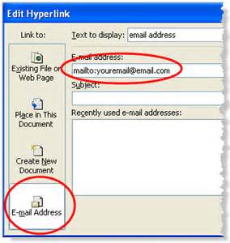


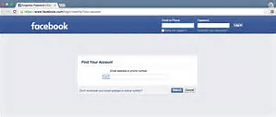
Note: Public Records Include…
…records of agency business when they are created or retained by agency employees or officials on home computers or devices, or in non-agency email accounts or files.

Slide 51

Text Messages (“Scope of Employment”) - Nissen v. Pierce County (Aug. 2015)
Text messages sent and received by a
public employee in the employee’s official
capacity are public records of the employer,
  regardless of the public or private nature of the device used to create them; thus, even if the employee uses a private cell phone.
A record that an agency employee prepares, owns, uses, or retains within the scope of employment is a record “prepared, owned, used or retained by a state or local agency” under the PRA.
  An employee’s communication is “within the scope of employment” when the job requires it, the employer directs it, or it furthers the employer’s interests.
  This inquiry is always case- and record-specific.

Slide 52
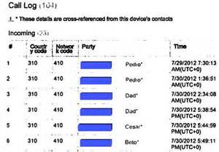
Call and Text Logs (“Use”)
- Nissen v. Pierce County
For a record to be “used” by an agency it must bear a nexus with the agency’s decision-making process.
A record held by a third party, without more, is not a “public record”, unless the agency “uses” it. In this case, that applied to call and text logs at the phone service provider which were not used by the agency (“the county did nothing with them”).

Slide 53



Post-Nissen v. Pierce County:
PRA requests for public records in a local elected official’s personal residence, on a personal computer, and in a personal email account (2016); and personal Facebook site (2018).
Court of Appeals:
  West v. Vermillion, Puyallup (2016): Public records in personal residence, on personal computer, in personal email account must be disclosed. The constitutions do not provide an individual a privacy interest in those public records. State Supreme Court denied review.
  West v. Puyallup (2018): Facebook posts on an elected official‘s personal site are public records if they relate to the conduct of government and are prepared within the scope of employment or official capacity.

Slide 54


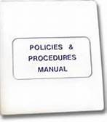

General PRA Procedures
Under PRA, agencies must:
Appoint a public records officer.
Publish procedures describing certain agency organization, operations, rules of procedure, and other items listed in PRA that:
  Provide full public access to public records,
  Protect public records from damage/disorganization
  Prevent excessive interference with other agency functions.
  Provide fullest assistance to requesters
  Provide most timely possible action on requests.
Publish fee schedule. See upcoming slide.
Maintain a list of laws the agency believes exempts or prohibits disclosure.
Provide certain indexes of records.
Make non-exempt records available for inspection and copying during customary business hours for a minimum of 30 hours per week, excluding holidays.
  Post customary business hours on the agency’s website and make hours known by other public means.
~ RCW 42.56.040, RCW 42.56.070 - .090, RCW 42.56.580.

Slide 55

New PRA Procedures
(ESHB 1594 and EHB 1595 – Eff. July 23, 2017)
Format for requests. No official format is required. Agencies can recommend requesters use their form or web page. Must accept in person requests made during normal office hours.
Log. Agency must keep a log of PRA requests (identity of requester if provided, date of receipt, text of request, description of records produced, description of records redacted/withheld and reasons, and date of final disposition.) RCW 40.14 (records retention).
Ordinances. Local agencies should consult AGO Model Rules in developing PRA ordinances.
~ RCW 42.56.080, RCW 42.56.570(4); RCW 40.14.026(4)

Slide 56

Requests (Cont.)
Requesters do not:
  Generally need to identify purpose of request, unless required by law (e.g., restriction on providing lists of individuals for a commercial purpose).
  Need to limit the number of requests they make.
  Need to exhaust an agency’s internal appeal procedures prior to seeking judicial review when a record is denied and two business days have passed. (Agencies are to have review mechanisms but review deemed completed after 2 business days following the denial of inspection.)
  ~ RCW 42.56.070, RCW 42.56.520, Zink v. City of Mesa

Slide 57

Requests (Cont.)
  EHB 1595 (eff. July 23, 2017): An agency may deny a “bot” request, under the criteria in the bill.
    A “bot” request is one of multiple requests from a requestor to the agency within a 24 hour period, if the agency establishes that responding to the multiple requests would cause excessive interference with other essential function of the agency.
    “Bot” request means a request for public records that an agency reasonably believes was automatically generated by a computer program or script.
~ RCW 42.56.080(3)

Slide 58
Requests (Cont.)
“Identifiable” records (cont.)
EHB 1595 (effective July 23, 2017):
“A public records request must be for identifiable records.”
  “A request for all or substantially all records, prepared, owned, use or retained by an agency is not a valid request for identifiable records under this chapter,
  “Provided that a request for all records regarding a particular topic or containing a particular keyword or name shall not be considered a request for all of an agency’s records.”
  ~ RCW 42.56.080

Slide 59

Requests (Cont.)
Requesters must:
  Clarify a request when an agency asks for clarification.
  Claim or review records when the records or an installment of records is ready.
  Comply with agency procedures including those that protect records from damage/disorganization (such as when viewing records).
  Provide a deposit when an agency requires a deposit.
  Pay for copies per fee schedule, including copies for an installment.
Requesters should also:
  Promptly communicate with agency,
  including to voice any concerns regarding agency action or inaction.
  ~ RCW 42.56.070(7) – (9), RCW 42.56.080, RCW 42.56.100, RCW 42.56.120, RCW 42.56.520, Model Rules, Zink v. City of Mesa, Hobbs v. State Auditor

Slide 60



Agency Responses to Requests
The agency has five business days to respond to a public records request.
Agency response can:
  Acknowledge receipt of the request and provide a reasonable estimate to respond; or
  Fulfill the request; or
  Provide an internet address and link to the records on the agency’s website (which fulfills part or all of the request); or
  Seek clarification (still need to give estimate of time)*; or,
  Deny the request with an accompanying written statement of the specific reasons.
  ~ RCW 42.56.520
  *ESHB 1594 (eff. July 23, 2017) – if request
  unclear, give estimate to greatest extent possible

Slide 61


Seeking Clarification
An agency can seek clarification of a request if it is not reasonably clear, or does not request “identifiable records.”
Remember: agency’s rules are to give “fullest assistance.”
Agency should explain why it needs clarification, in order to provide fullest assistance to requester and to search for potentially responsive records.*
If requester does not respond to request for clarification, the agency may close the request.*
  ~ RCW 42.56.520
  *ESHB 1594 (eff. July 23, 2017)
  Agency must respond
  to parts of request that are clear.

Slide 62

Estimate of Time for Further Response
An agency can provide an estimate of time for further response. Further response includes estimate to produce first installment.
Estimate is to be reasonable.
Factors may include, for example, time needed to:
  Get clarification if necessary.
  Search for records. More time may be needed if request is large or complex.
  Assemble and review records.
  Provide notice to affected third persons/agencies.
  Prepare an exemption log if necessary.
  Perform other essential agency functions.
An agency can extend the time if needed.
~ RCW 42.56.520, RCW 42.56.080, RCW 42.56.550; Andrews v. Washington State Patrol; Hobbs v. State

Slide 63

Searches
An agency must conduct an adequate search for responsive records.
The search should be reasonably calculated to uncover responsive records.
The search should follow obvious leads to possible locations where records are likely to be found.
If responsive public records are on or in employees’ personal devices, personal accounts, or personal files, those must be searched, too.
The focal point of the judicial inquiry is the agency’s search process, not the outcome of the search.
The agency bears the burden of proof to show the adequacy of the search.
~ RCW 42.56.520; Neighborhood Alliance of Spokane v. Spokane County; Hobbs v. State; Block v. City of Gold Bar; Nissen v. Pierce County.

Slide 64


Installments
Agencies can provide records in installments, particularly for larger requests.
Agencies can request a deposit up front for copies (not to exceed 10 percent).
Agencies can provide an installment by providing links to records on its website.
  Note: Agencies are encouraged to post commonly-requested records on their websites. This:
    Makes records more accessible.
    Enables quicker agency responses.
    Enables requesters to choose to view or copy only those records they want.
~ RCW 42.56.080, RCW 42.56.120

Slide 65

“Mechanics” of Searching/Producing Public Records Controlled by Employee
The public employee must obtain, segregate and produce to the employer those public records that are responsive to a PRA request from the employee’s personal accounts, files, and devices.
Employee may be required to submit affidavit regarding his/her search.
~ Nissen v. Pierce County

Slide 66

Exemptions
Records are presumed open.
If a record, or part of a record, is withheld from the public, the agency must cite to an “exemption” in law and give a brief explanation.
Exemptions are narrowly construed.
The general rule is the agency withholds only the exempt information, and releases the rest.
Exemptions must be authorized in law --- in PRA or other laws.
~ RCW 42.56.050, RCW 42.56.210 - .510, RCW 42.56.550

Slide 67

Exemptions (Cont.)
When withholding part (redacting) or all of a record, agency must describe record by date, type, authors/recipients, and total number of pages.
Agency must list exemption and give brief explanation.
This information can be provided to the requester in an “exemption log” or in other formats, so long as the required information is provided.
Common exemptions are certain information in student or employment records, attorney-client privileged information, pending investigative records in certain investigations, and protected health care information.
The agency bears the burden of proof to justify the exemption.
~ RCW 42.56.050, RCW 42.56.210 - .510, RCW 42.56.550

Slide 68

Privacy
There is no general “privacy” exemption in the PRA.
If privacy is an express element of another exemption, privacy is invaded only if disclosure about the person would be:
  “Highly offensive to the reasonable person” and
  “Not of legitimate concern to the public.”
  ~ RCW 42.56.050
  This means that if information does not satisfy both these factors, it cannot be withheld as “private” information under other statutes.
  (Pending: State Supreme Court case involving constitutional privacy.)

Slide 69

Fees
EHB 1595 (effective July 23, 2017):
Copy fee schedule:
  Agencies can charge actual costs (following certain procedures & notice/public hearing) or
  Default statutory costs (following a declaration of undue burden in rule; list of costs in statute).
  Alternative flat fee up to $2 for entire request (see details in statute)
EHB 1595’s default schedule includes paper copies, scanned copies, electronic records costs.
No fee for records routinely posted on agency website.
Must provide an estimate of costs to requester upon request.
Act provides for other fee arrangements in defined circumstances.
“Customized access charge” under defined circumstances.
No fees for inspection.
Court action can be brought to challenge agency’s estimate of fees.
~ RCW 42.56.120, RCW 42.56.130, RCW 42.56.550

Slide 70

Electronic Records Production & Disclosure – The Basics for Agencies
Remember definition of “public record” – includes electronic records: emails, texts, databases, social media records, electronic versions of printed documents, Excel spreadsheets, PowerPoint presentations, website records, videos, audio recordings, etc. Includes public records on/in personal devices/accounts.
Note other legislative statements:
    RCW 43.105.351: … It is the intent of the legislature to encourage state and local governments to develop, store, and manage their public records and information in electronic formats to meet their missions and objectives. Further, it is the intent of the legislature for state and local governments to set priorities for making public records widely available electronically to the public.
    Chap. 69, Laws of 2010: The internet provides for instant access to public records at a significantly reduced cost to the agency and the public. Agencies are encouraged to make commonly requested records available on agency web sites. When an agency has made records available on its web site, members of the public with computer access should be encouraged to preserve taxpayer resources by accessing those records online.

Slide 71



Electronic Records Production & Disclosure – The Basics (Cont.)
Remember there can be changes/developments
in law (statutes, case law) including as they impact
electronic public records. Examples:
  RCW 42.56.152: Public records officers’ required training on electronic records (retention, production & disclosure, updating & improving technology information services).
  RCW 42.56.120:
    Fees for copies of electronic records.
    Bot requests.
    Translating a records into an electronic format (including scanning a paper record) is not creating a new record.
    Local governments: consultation programs, competitive grant program. (RCW 40.14.026)
  O’Neill v. City of Shoreline: Nissen v. Pierce County; West v. Vermillion, Puyallup; West v. Puyallup
    Producing public records located on/in home computers, personal devices, personal accounts.

Slide 72

Electronic Records Production & Disclosure – Redaction Mechanics
Electronic records redaction:
  Various software programs permit standard redactions on many electronic records (Adobe Acrobat X Pro, Informative Graphics Redact-it, RapidRedact, and similar technologies).
  Not all agencies have such software, or software than can electronically redact all electronic records.
    For example, there may be “non-standard” redactions in some types of electronic records (videos, audios, photos, etc.) that require particular software.
  In some circumstances, due to lack of software or other technical issues, it may be necessary to print out a copy of the electronic record and apply the redactions to the paper record.
  An agency may need to work with its IT staff and legal counsel on such issues.

Slide 73

Electronic Records Production & Disclosure – Production Mechanics
Electronic records can be produced/delivered electronically in many ways. Delivery practices may vary among agencies, depending upon agency resources, software, or other issues (e.g. limits on size of files that can be sent/received by email).
Some examples:
  Posting them on agency’s web site and provide requester links to specific records.
  Delivering copies on a CD, DVD, thumb drive/flash drive.
  Delivering by email.
  Delivering through an agency portal or cloud-based delivery (File Transfer Protocol - FTP).
  Arranging for inspection at an agency’s office, on an agency computer.
  See AGO Model Rules.

Slide 74



Electronic Records Production & Disclosure – Updating & Improving Technology Information Services
Agencies can consider making their websites - current technology - more robust. Examples:
  Posting more commonly requested records.
  Posting information about how to search for records.
  Posting more information about how to request records (agency’s PRA procedures, fee schedule, request form, contact information for Public Records Officer, etc.).
Agencies can consider new technology purchases
to assist them in retaining/producing records.
  Examples: Portals; electronic redaction tools; texting/website capture and retention software; other software.
  Master state contracts: Several vendors awarded statewide master contracts for retention - “Enterprise Content Management Systems.” State, & local agencies can use. More information on State Archives website and Department of Enterprise Services website.
  Local government grants (State Archives). RCW 40.14.026.

Slide 75

Enforcement & Penalties
PRA enforced by courts for claims listed in PRA.
A court can impose civil penalties. No proof of “damages” required.
A court is to consider factors in requiring an agency to pay a penalty.
Plus, a court will award the prevailing requester’s attorneys fees and costs.
Special penalty provisions and court procedures apply to lawsuits involving inmate requests.
  ~ RCW 42.56.550, RCW 42.56.565; Yousoufian v. Sims

Slide 76


Penalty Factors
A court must consider these nonexclusive factors in deciding whether an agency should pay a penalty:
Mitigating factors (factors that can reduce a penalty):
A lack of clarity in the PRA request.
The agency's prompt response or legitimate follow-up inquiry for clarification.
The agency's good faith, honest, timely, & strict compliance with all PRA procedural requirements & exceptions.
Proper training & supervision of the agency's personnel.
The reasonableness of any explanation for noncompliance by the agency.
The helpfulness of the agency to the requester.
The existence of agency systems to track and retrieve public records.
  ~ Yousoufian v. Sims

Slide 77

Aggravating factors (factors that can increase a penalty):
A delayed response by the agency, especially in circumstances making time of the essence.
Lack of strict compliance by the agency with all the PRA procedural requirements and exceptions.
Lack of proper training & supervision of the agency's personnel.
Unreasonableness of any explanation for noncompliance by the agency.
Negligent, reckless, wanton, bad faith, or intentional noncompliance with the PRA by the agency.
Agency dishonesty.
The public importance of the issue to which the request is related, where the importance was foreseeable to the agency.
Any actual personal economic loss to the requestor resulting from the agency's misconduct, where the loss was foreseeable to the agency.
A penalty amount necessary to deter future misconduct by the agency considering the size of the agency and the facts of the case.
The inadequacy of an agency’s search for records.
  ~ Yousoufian v. Sims; Neighborhood Alliance v. Spokane
  County

Slide 78

Penalties Outside of PRA
Penalties in Other Laws:
There can be criminal liability for willful destruction or alteration of a public record.
~ RCW 40.16.010
For state employees, penalties can be assessed under the State Ethics Law if an employee intentionally conceals a record that must be disclosed under the PRA, unless decision to withhold was in good faith.
~ RCW 42.52.050

Slide 79

Open Government Risk Management Tips
Establish a culture of compliance with the OPMA & PRA.
Receive training on the OPMA & PRA.
Review available resources; institute best practices.
Keep updated on current developments in OPMA & PRA; correctly apply law.
  Remember: the OPMA & PRA can change through amendments, or develop through case law.
  Remember: other laws can govern an agency’s meeting procedures or records.
Consult with agency’s legal counsel.

Slide 80


AGO Open Government Assistance
The Washington State Attorney General’s Office has provided an explanatory pamphlet and other materials about the PRA & OPMA on its website at www.atg.wa.gov.
The AGO has also published PRA Model Rules.
The Attorney General has also appointed an Assistant Attorney General for Open Government. The AGO can provide technical assistance and training.
The AGO may provide records consultation services for local governments. http://www.atg.wa.gov/pra-consulting-program
The AGO Government Training Web Page with training resources, videos, and other materials is at:
http://www.atg.wa.gov/open-government-training
The AGO may also review a state agency denial of a record when the agency concludes the record is exempt.
~ RCW 42.56.155, RCW 42.56.570,
RCW 42.56.530, RCW 42.30.210

Slide 81


AGO Training
The “Open Government Trainings Act” requires OPMA & PRA training for specified persons. RCW 42.30.205; RCW 42.56.150; RCW 42.56.152.
Refresher training occurs no later than every 4 years.
Training can be taken online, in person, or by other means.
Training resources, videos, and more information about the Act (a “Q & A”) are available on the Attorney General’s Office Open Government Training Web Page: http://www.atg.wa.gov/OpenGovernmentTraining.aspx

Slide 82
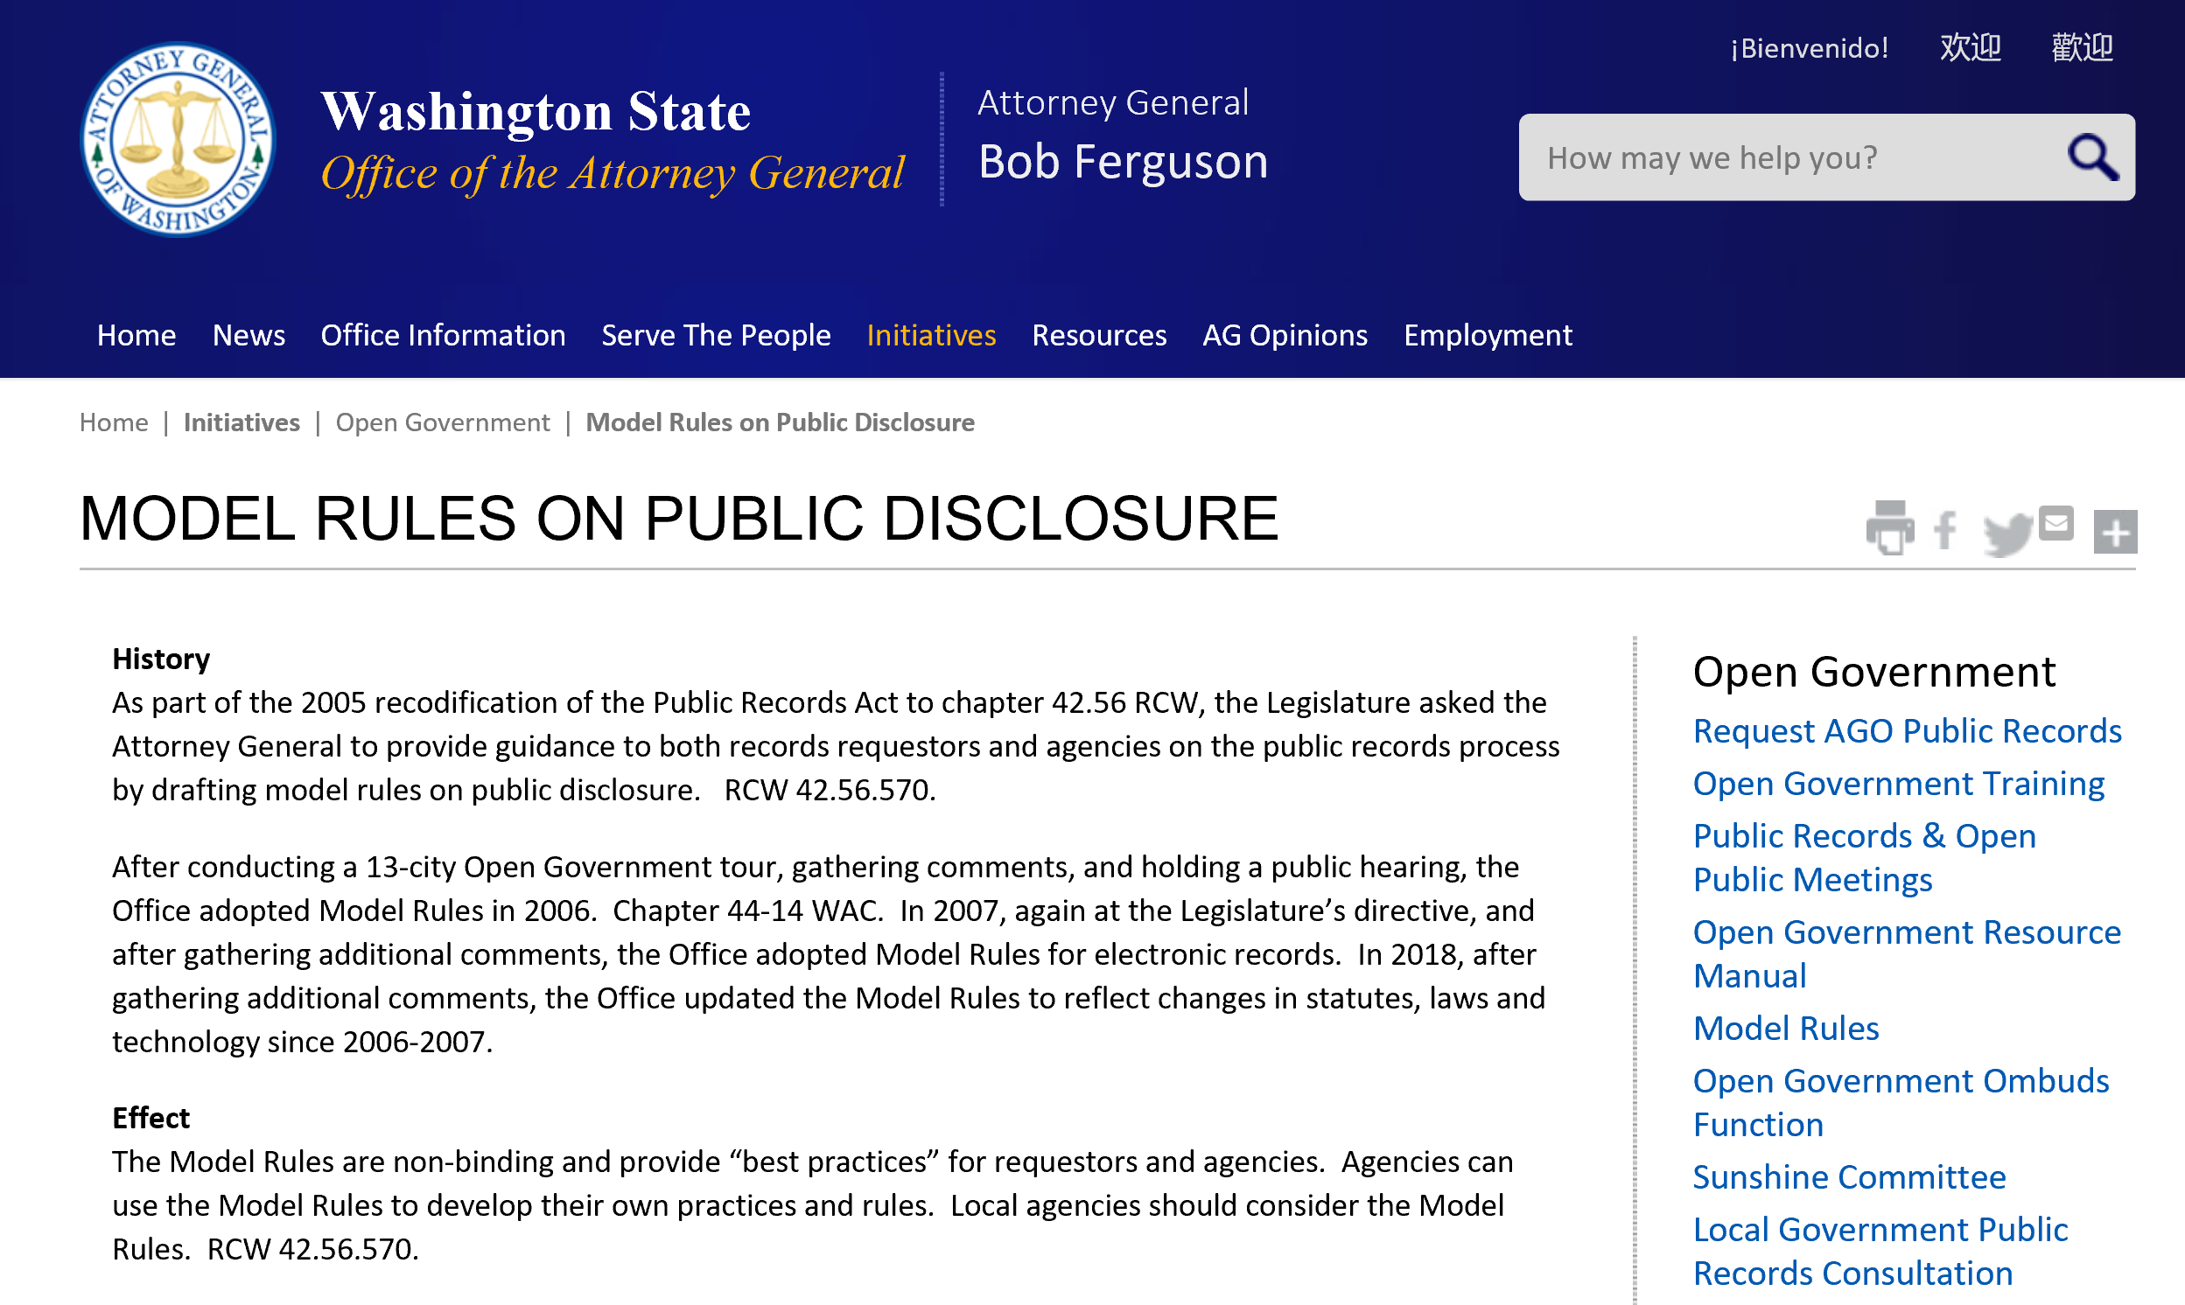
AGO PRA Model Rules – ch. 44-14 WAC

Slide 83


AGO Open Government Resource Manual – Available on AGO Website*
Updated October 31, 2016**
* http://www.atg.wa.gov/open-government-resource-manual
**Does not yet include statutory changes resulting from 2017-18 sessions.

Slide 84

AGO Guidance Document on Filling Vacant Positions

Slide 85
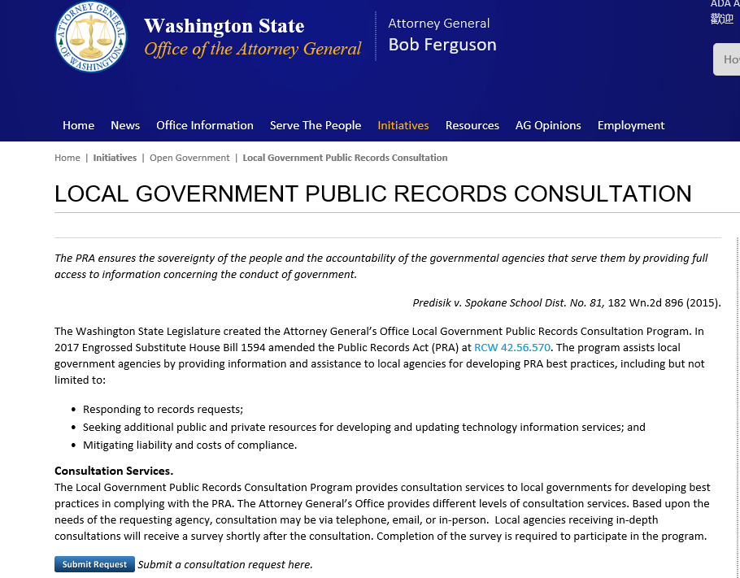

AGO Local Gov’t Records Consultation Program
https://www.atg.wa.gov/pra-consulting-program

Slide 86
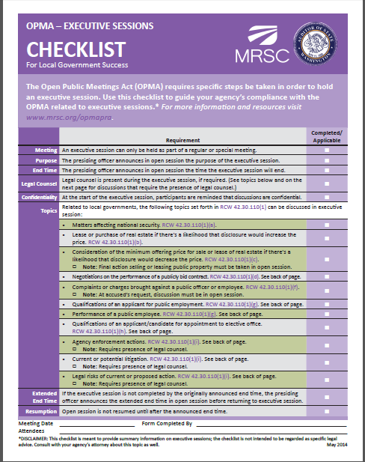
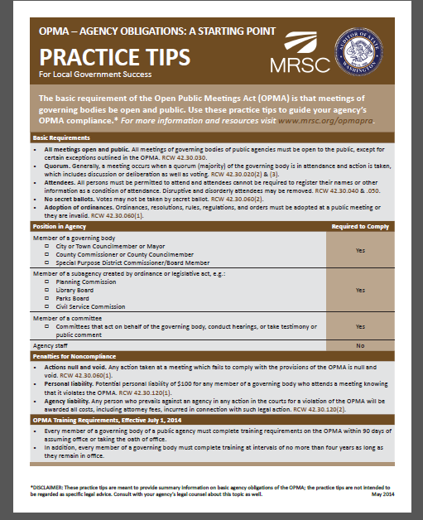
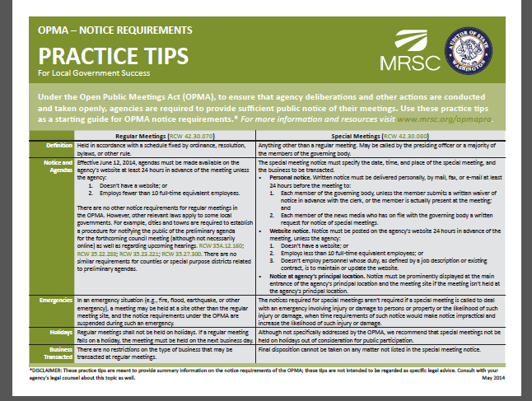
Municipal Research & Services Center – Another Resource

Slide 87
